Slide 1
Direct Marketing Campaign of a Portuguese Banking Institution
Group 9
Dataset Link: https://www.kaggle.com/ruthgn/bank-marketing-data-set

Slide 2
Team Members
Student Name | Student ID
Shashwat Rahul Sachdeva | 0768857
Tushar Rajendra Shinde | 0791249
Archit Raju Asutkar | 0789221
Weeramundage Ishani Madushika Piyathilake | 0796108
Dhrumi Tapas Patel | 0793770

Slide 3
Background / Motivation:
It is important for banking institutions to verify the performance of their classification models and to explore the best strategies to improve institution's next direct marketing campaign.
To identify the most prominent methodology to determine the more effective marketing campaigns would be a data driven approach.
It is required the institutions to analyze gathered data and then come to an error-free definitive conclusion

Slide 4
Problem Statement:
Term Deposit/Fixed deposits are the cash investments held by the banking institutions for their revenue generation. However, it is important for financial institutions to market them. Two ways in which this can be accomplished is - Digital Marketing and Telemarketing. Apparently, Telemarketing remains the most prominent one due to high conversion rate hence requires huge investments. How can we have more effective marketing campaigns in the future?

Slide 5
Project Proposal:
In this project, we will examine the Bank lead's dataset and make a grouping calculation with full end feature engineering and EDA.
Objectives of project:
1. Meet and Greet Data
2. Prepare the Data for consumption (Feature Engineering and Selection)
3. Perform Exploratory Analysis (Visualizations)
4. Model the Data using Machine Learning
5. Validate and implement data model
6. Optimize and Strategize

Slide 6
Analysis Questions:
As the future is all about digitalization can we have more effective campaigns via social media ?
Is there a relation between job title /age /education /martial status & loan defaults?
Based on the relation between martial status, type of loan and type of marketing can we figure out optimal method of marketing(Telemarketing or Digital marketing)?
How do different age groups respond to different methods of marketing for bank loans?

Slide 7
Dataset Descriptions:
This data set contains records relevant to a direct marketing campaign of a Portuguese banking institution.
The marketing campaign was executed through phone calls.
Below we have represented Uni-Variate and Bi-Variate analysis for variables along with the bar plot, scatter plot and pie chart.

Slide 8
Variables | Types
Age | Numeric
Job | Categorical
martial | Categorical
education | Categorical
default | Categorical
housing | Categorical
loan | Categorical
contact | Categorical
month | Categorical
Variables | Types
day_of_week | Categorical
campaign | Numeric
pdays | Numeric
previous | Numeric
poutcome | Categorical
emp.var.rate | Numeric
cons.price.idx | Numeric
cons.conf.idx | Numeric
euribor3m | Numeric
nr.employed | Numeric
y | Categorical

Slide 9
Univariate Analysis:
We have performed univariate analysis on all the numerical & categorical variables and plotted a pie chart as below.
From the below-mentioned charts we can observe that how lucid is the transformation and visualization for univariate variables. Divided segments are representing an individual element.
Reason behind performing univariate analysis is to understand the trends and patterns of data
Analyze the frequency and other such characteristics of data
Know the distribution of the variables in the data.
Visualize the relationship that may exist between different variables

Slide 10
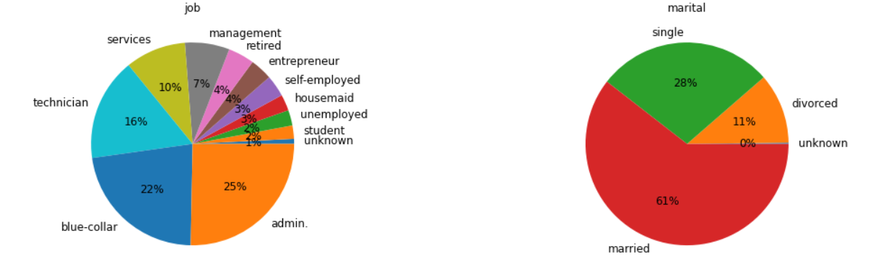
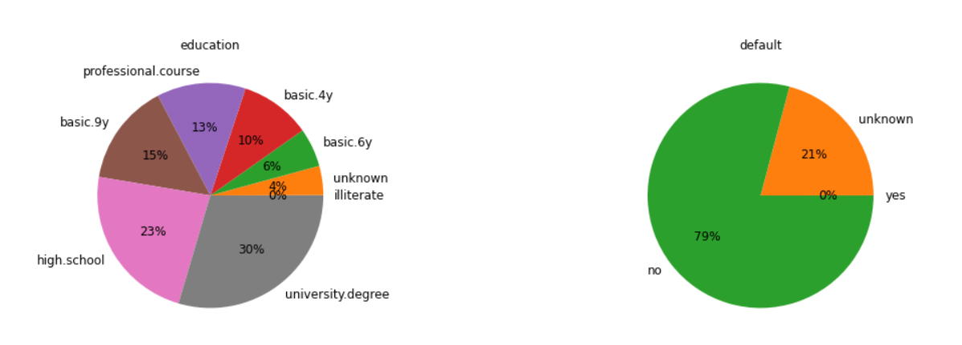
Pie- Charts Visualization for Univariate Variables:

Slide 11
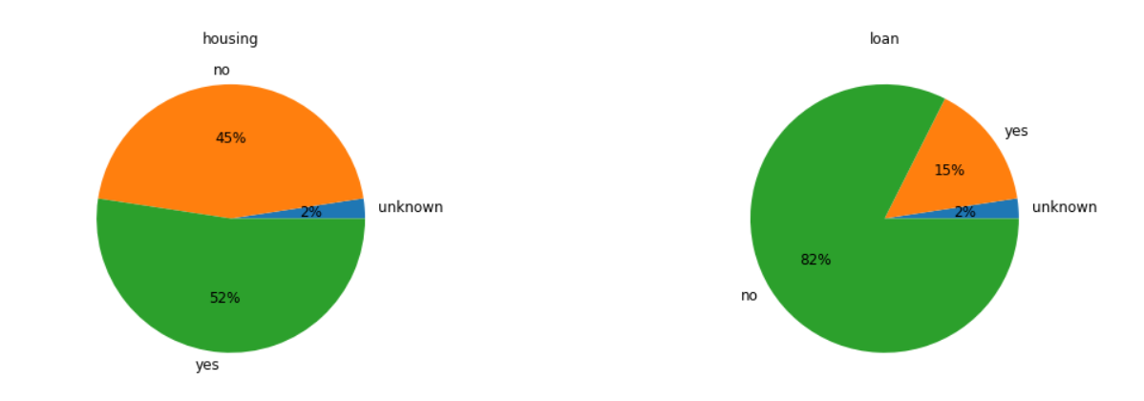
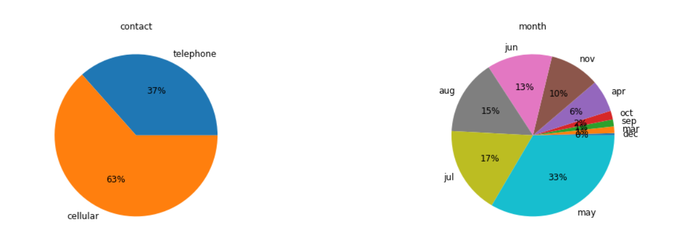
Pie- Charts Visualization for Univariate Variables:

Slide 12
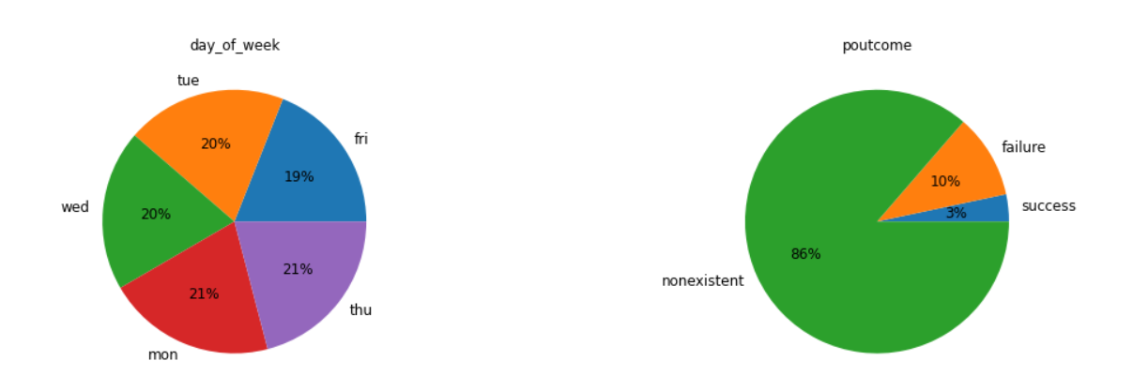
Pie- Charts Visualization for Univariate Variables:

Slide 13
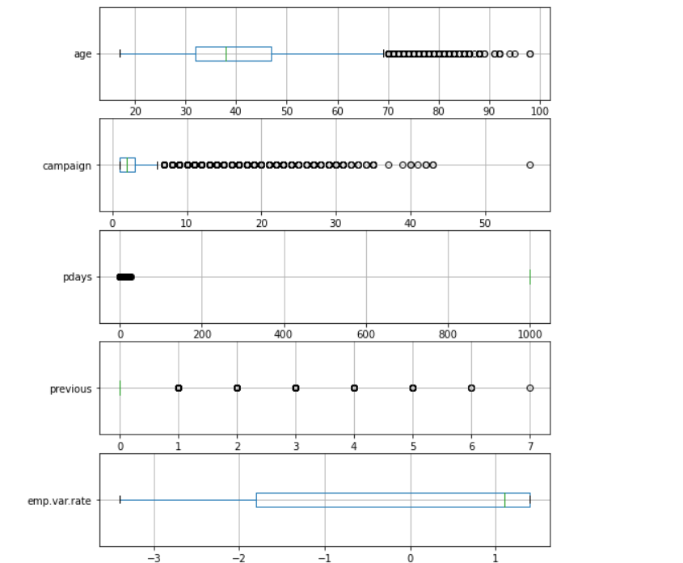
Pie- Charts Visualization for Univariate Variables:

Slide 14
Bi-Variate Analysis:
Bivariate analysis is utilized to track down the connection between two variables.
Analysis can be performed for mix of categorical and continuous factors.
Scatter plot is appropriate for breaking down two constant factors. It demonstrates the linear or non-linear connection between the factors.
Bar graphs assist with the understanding the connection between two categorical factors.
Certain factual tests are likewise used to viably comprehend bivariate relationships.
Scipy library has broad modules for playing out these tests in Python

Slide 15
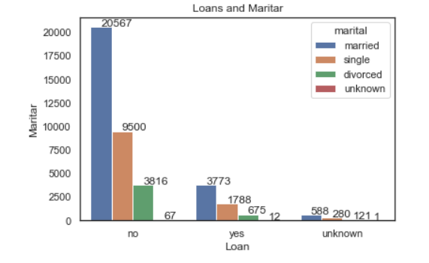
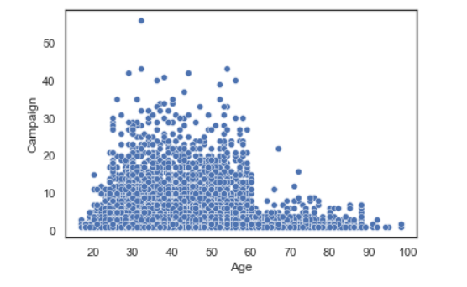
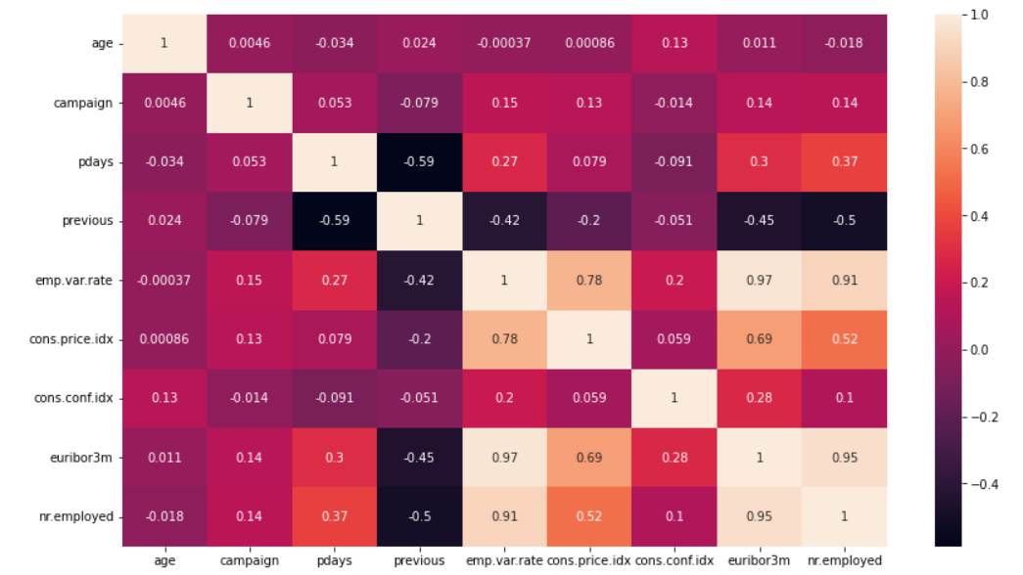
Bar Plot – Scatter Plot for Bi-Variate Variables:

Slide 16
Transformation Steps:
Transformation of our banking dataset we expect rigorously. Initially we studied the dataset. The steps which we are performing are as follows:
To check the data set volume.
To find the data variable types.
We are going to check if null values exists and determine whether they have so much impact and need to omit them records.
Perform Uni-variate analysis of the data to find outliers and imbalance of the data.

Slide 17
Data Cleaning / Transformation
Banking dataset does not have any missing values in any of the variables.
We constructed multiple attempts to find out missing values, irrelevant data and unwanted variables.
We felt that column default is unnecessary for us to we dropped that column from our dataset.

Slide 18
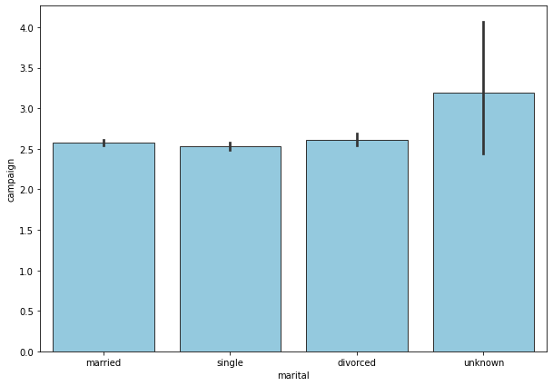
Electronic Design Automation [EDA]:
We have created different types of visualizatons using EDA.

Slide 19
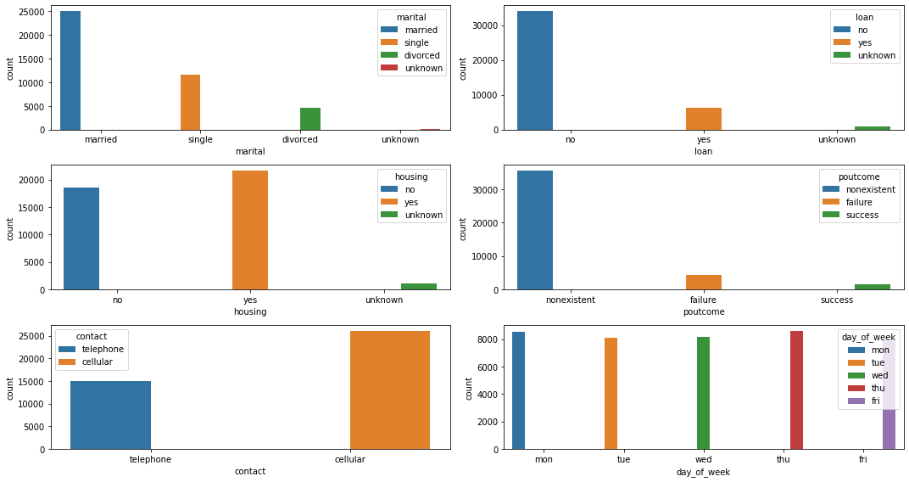
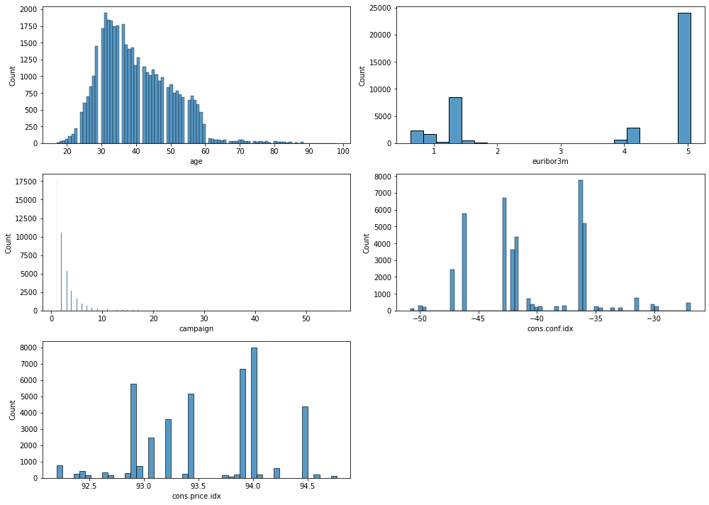

Slide 20
The bar chart represents the number of contacts performed during this campaign and for given marital status.
We can clear see that number of contacts performed is greater for unknown marital status on the other hand single sort from the variable seems less contacted.

Slide 21
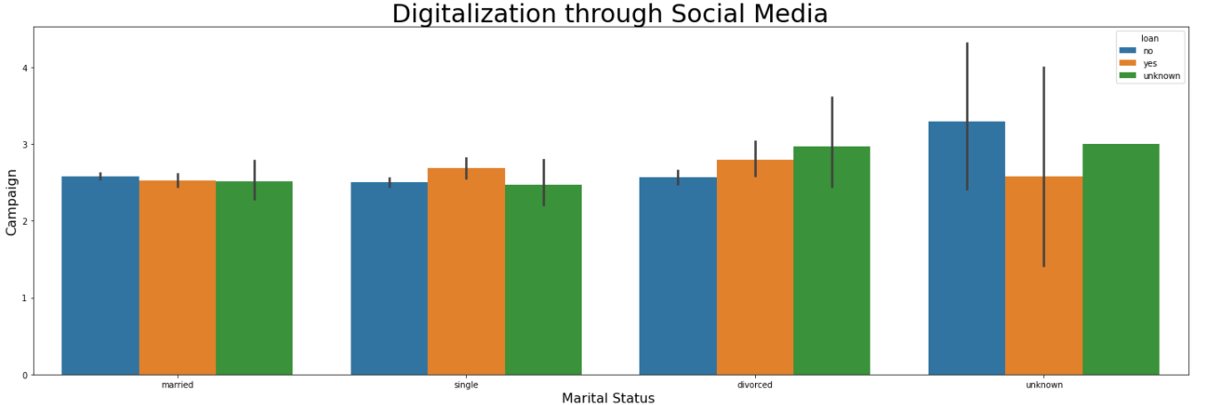
Data Analysis
As the future is all about digitalization can we have more effective campaigns via social media ?
We can predict that singles and the poeple who have deposited the loan could attend campaign via social media. The reason being we assume singles having age 20-30. So, young generation obviously use Social Network.

Slide 22
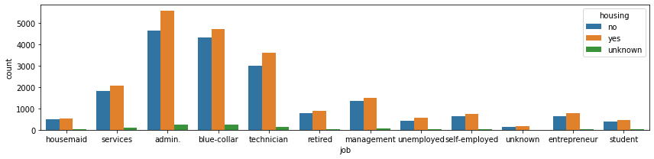
Data Analysis
Is there a relation between job title /age /education /martial status & loan defaults?

Slide 23
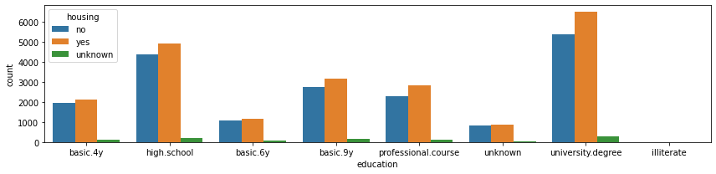
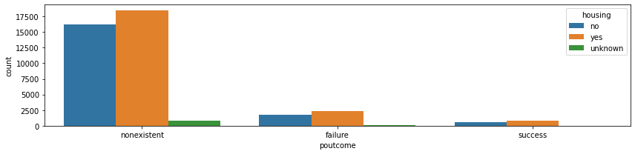

Slide 24
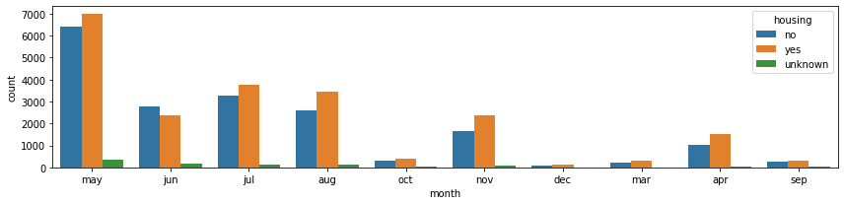
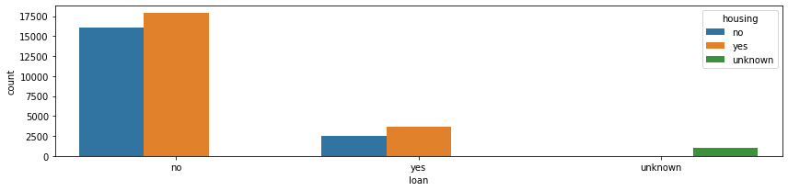

Slide 25
From this analysis, we can see that variables reacted very well with the visualization
Initial plot represents the housing loan against marital status. We can observe that married people achieved highest number of count amongst others. It shows how these two variables are connected to each other.
Each plot describes the feature of a variable based relevant to our target variable y.
There exists multiple number of univariate outliers in Age and Campaign data.

Slide 26
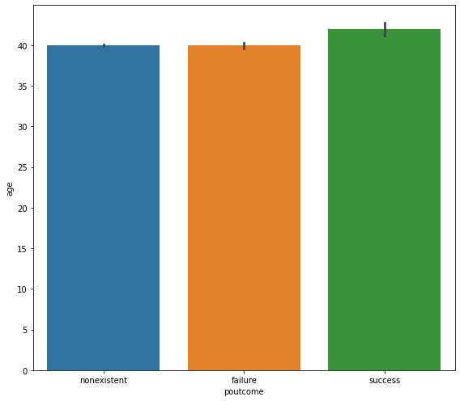
How do different age groups respond to different methods of marketing for bank loans?

Slide 27
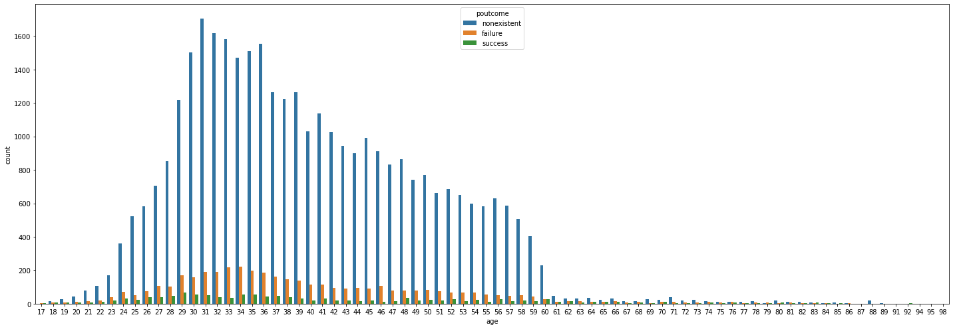

Slide 28
According to the dataset, to observe the behaviour between different age groups and methods for marketing bank loans we implemented count plot and bar plot for better visualization and understanding.
Success : In our banking dataset the age above 40 achieved success in their banking terms. So, we can predict that age experience matters when you experiencing banking elements.
Failure: Majority of the people faced failure in banking. The factors which affected the poutcome might be the variables.
Non-existent: We could have dropped this element from the variables poutcome but we wanted to see the count of non-existed people in banking dataset.

Slide 29
Based on the relation between martial status, type of loan and type of marketing can we figure out optimal method of marketing(Telemarketing or Digital marketing - subscribed term deposit)
To figure the above-mentioned terminology we need to use three variables in a plot, either we can choose scatter plot or bar plot but in this case we chosen bar plot.
Following we showed connection between target variable respective number of contacted persons.
Based on the response of client subscribed term deposit, we showed visulaization.

Slide 30
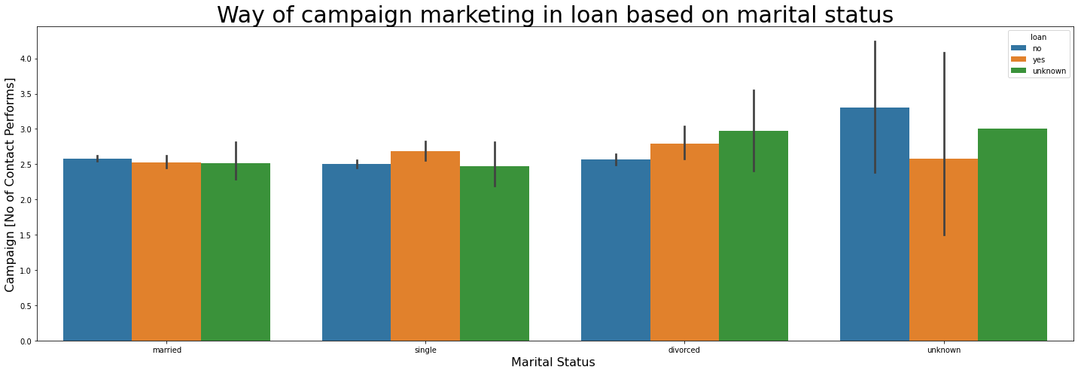
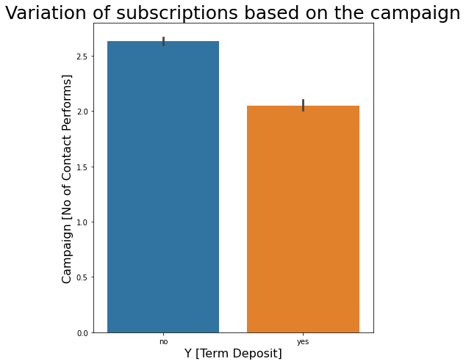

Slide 31
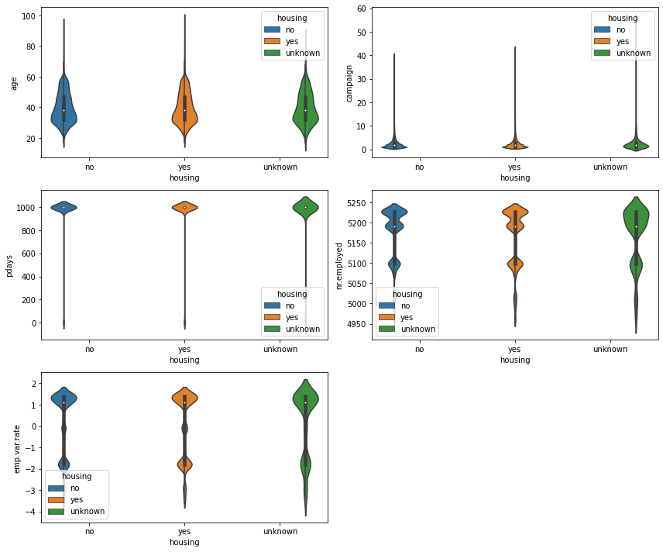
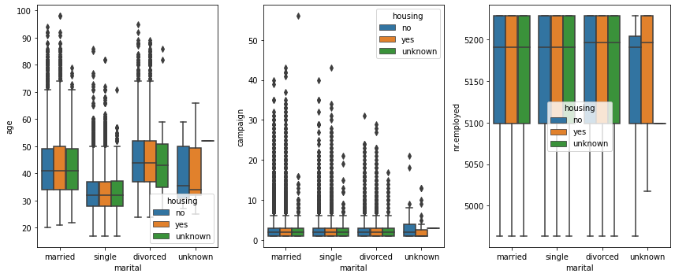

Slide 32
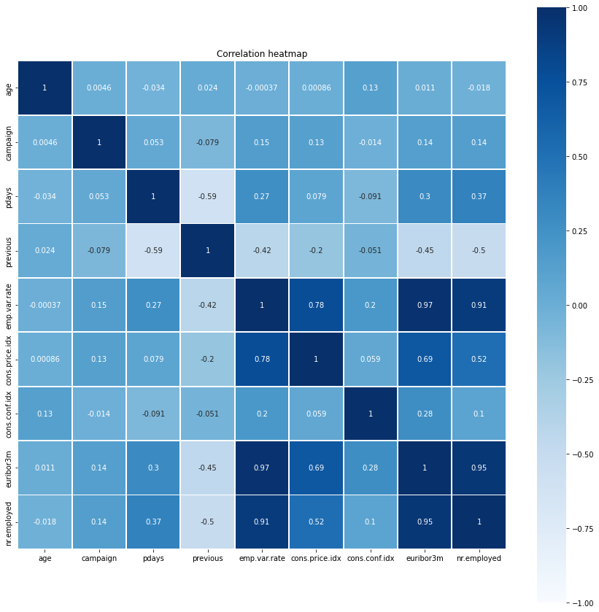
Corelation Heatmap:

Slide 33
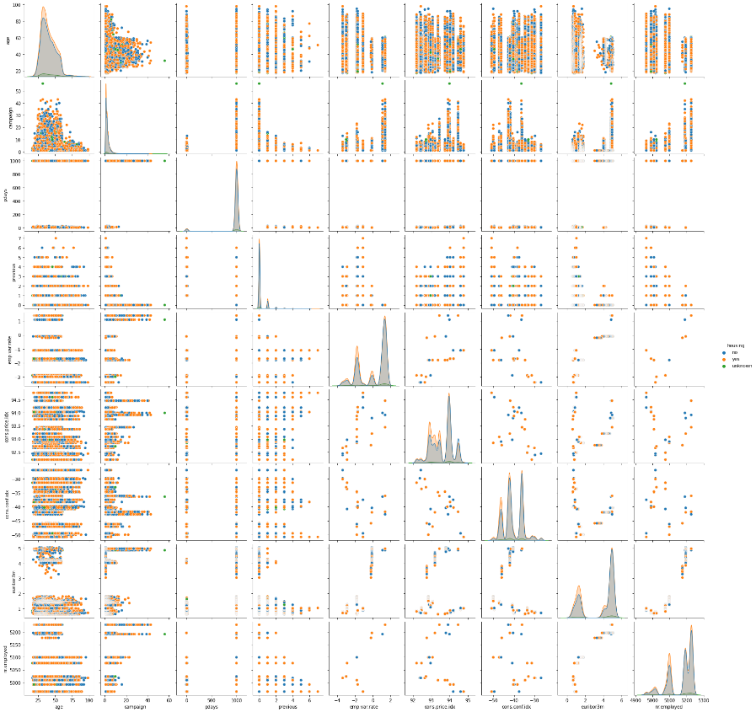
Pairwise relations in dataset:

Slide 34
Conclusion
We believe that the variables marital, age, emp.var.rate, campaigns and Y projected a positive trend amongst others. Also we visualized term deposited by each age group.
In conclusion, banking dataset performed a linear visualization. We tried our best to represent the variables.

Slide 35
References:
Dataset Link: https://www.kaggle.com/ruthgn/bank-marketing-data-set
Google Collab Link: https://colab.research.google.com/drive/1435nEpfQp61eiQAXKt1K0CCES0pufT34?usp=sharing

Slide 36
Thank you

